Slide 1

JavaScript Basic
By
BJIT Academy
Image Placeholder

Slide 2
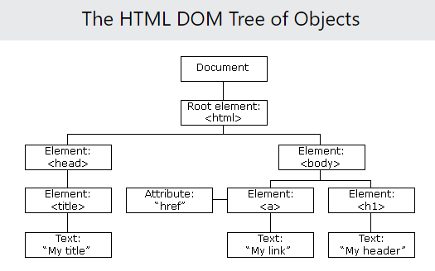
The HTML DOM (Document Object Model)
When a web page is loaded, the browser creates a Document Object Model of the page.
The HTML DOM model is constructed as a tree of Objects:

Slide 3

Java Script
JavaScript (JS) is a lightweight interpreted (or just-in-time compiled) programming language with first-class functions. While it is most well-known as the scripting language for Web pages

Slide 4
JavaScript Variables
In a programming language, variables are used to store data values.
JavaScript uses the keywords var, let and const to declare variables.
An equal sign is used to assign values to variables.
In this example, x is defined as a variable. Then, x is assigned (given) the value 6:
let x;
x = 6;

Slide 5
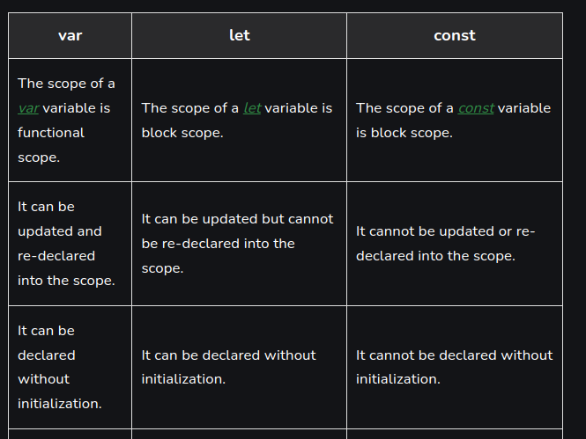
Differences between var, let, and const:

Slide 6
JavaScript
JavaScript Operators
JavaScript Expressions
JavaScript uses arithmetic operators ( + - * / ) to compute values:
(5 + 6) * 10
An expression is a combination of values, variables, and operators, which computes to a value.
The computation is called an evaluation.
For example, 5 * 10 evaluates to 50:
5 * 10

Slide 7
JavaScript Arithmetic Operators
Arithmetic operators perform arithmetic on numbers (literals or variables).
Operator Description
+ Addition
- Subtraction
* Multiplication
** Exponentiation (ES2016)
/ Division
% Modulus (Remainder)
++ Increment
-- Decrement

Slide 8
JavaScript Data Types
JavaScript has 8 Datatypes
The Object Datatype
1. String
2. Number
3. Bigint
4. Boolean
5. Undefined
6. Null
7. Symbol
8. Object
The object data type can contain:
1. An object
2. An array
3. A date

Slide 9
JavaScript Functions
A JavaScript function is defined with the function keyword, followed by a name, followed by parentheses ().
Function names can contain letters, digits, underscores, and dollar signs (same rules as variables).
The parentheses may include parameter names separated by commas:
(parameter1, parameter2, ...)
The code to be executed, by the function, is placed inside curly brackets: {}
function name(parameter1, parameter2, parameter3) {
// code to be executed
}

Slide 10
JavaScript Objects
Objects are variables too. But objects can contain many values.
This code assigns many values (Fiat, 500, white) to a variable named car:
const car = {type:"Fiat", model:"500", color:"white"};

Slide 11
Different types of functions
Function Expression
Anonymous Function
A function can be declared using a function expression. It is declared quite differently from the general syntax because it uses a variable to denote the name of the function.
This variable comes before the keyword function. The function is invoked by calling out the variable with trailing parenthesis and semicolons:
Anonymous function declaration allows function names to appear hidden in the declaration itself.
In the general function declaration syntax, the function name is attached to the function keyword, but an anonymous function is declared using only the function keyword and a parenthesis.

Slide 12
Different types of functions
Hoisting
Arrow Function
With JavaScript functions, it is possible to call functions before actually writing the code for the function statement and they give a defined output. This property is called hoisting.
Hoisting is the ability of a function to be invoked at the top of the script before it is declared.
Since the function is hoisted at the top of the block but not initialized, it cannot be used until it has been declared. Recalling earlier examples:
This is a feature available in the ES6 version of JavaScript and as such has not stayed in the space for as long as the other features in the function declaration.
It is generally a cleaner way of creating JavaScript functions and it is similar to the function expression.

Slide 13
Thank You
Image Placeholder

